Slide 1
Cryptography
By Justin Ruiloba

Slide 2

Background
Cryptography is a security feature that is added to a message to keep the contents of a message private between the sender and receiver by using a agreed upon key.
Julius Caesar used encryption to cipher letters and messages.
Encryption has played an important role in many wars and throughout the years, but is beginning to be used more and more in the private and public sectors.
The ancient Greeks were one of the first ones to use cryptography using a stick and strip of cloth. They would wrap the cloth around the stick write their message then send the cloth and if you had a stick with similar length you would wrap it around the stick and see your message.

Slide 3
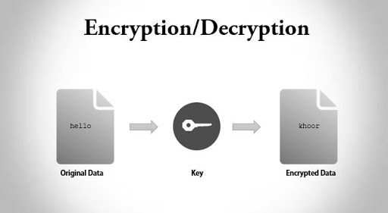
Outcomes
Through hands-on activities, participants will:
Understand the importance of encrypting messages for security
Employ the concept of encryption and decryption to a message
Experiment with reverse engineering techniques associated with decryption of a message.
Decode and encode a secret message.
Learn the fundamentals of cryptography
Use openssl to encrypt and decrypt

Slide 4


Scenario
You are an intern researcher for the government who is tasked with figuring out and comparing different algorithms for cryptography, how they work, and which to use in order to protect your research from getting stolen. You will be experimenting with different algorithms and ciphers to find out this answer. Then applying them to see how they work.

Slide 5

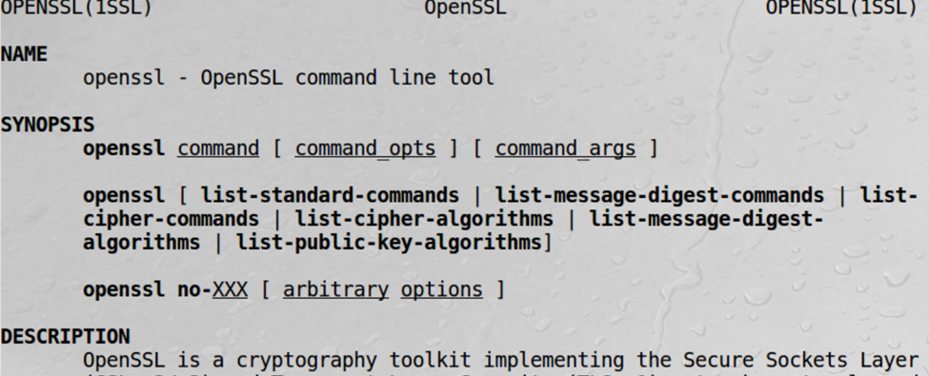

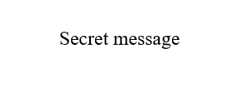

Tasks
Apply simple and complex encryption and decryptions by hand.
Look at the encrypted and decrypted message and alter it in leaf pad.
OpenSSL to encrypt and decrypt.
Learn the fundamentals of cryptography

Slide 6


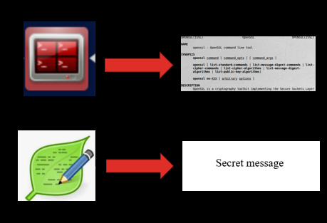


Cryptography Workshop by Justin Ruiloba
Background
Cryptography is a security feature that is added to a message to keep the contents of a message private between the sender and receiver.
Julius Caesar used encryption to cipher letters and messages.
Encryption has played an important role in many wars throughout the years but is beginning to be used more and more in the private and public sectors.
The ancient Greeks were one of the first ones to use cryptography using a stick and strip of cloth. They would wrap the cloth around the stick write their message then send the cloth and if you had a stick with similar length you would wrap it around the stick and see your message.
Outcomes
Through hands-on activities, participants will:
Understand the importance of encrypting messages for security
Employ the concept of encryption and decryption to a message
Experiment with reverse engineering techniques associated with decryption of a message
Decode and encode a secret message
Scenarios
Tasks
Apply simple and complex encryption and decryptions by hand.
Look at the encrypted and decrypted message and alter it in leaf pad.
OpenSSL to encrypt and decrypt.
Learn the fundamentals of cryptography
You are an intern researcher for the government who is tasked with figuring out and comparing different algorithms for cryptography, how they work, and which to use in order to protect your research from getting stolen. You will be experimenting with different algorithms and ciphers to find out this answer and applying them to see how they work.

Slide 7
References
https://www.nsa.gov/Portals/70/documents/about/cryptologic-heritage/historical-figures-publications/publications/misc/fun-facts-sheet.pdf
https://blog.pcloud.com/were-sure-you-dont-know-these-10-interesting-facts-about-encryption/#:~:text=It%20includes%20the%20coding%20and,of%20encryption%20is%20letter%20substitution.
https://marvelous-essays.com/blog/interesting-facts-about-cryptography.html
https://towardsdatascience.com/the-basics-of-cryptography-80c7906ba2f7
http://www.trytoprogram.com/c-examples/c-program-to-encrypt-and-decrypt-string/
https://www.tlnt.com/to-really-know-your-culture-become-a-detective/
https://www.barewalls.com/art-print-poster/bad-guy-in-jail_bwc11383384.html
https://fineartamerica.com/featured/a-great-gift-for-business-minded-persons-saying-profit-tshirt-design-money-bag-dollars-gold-coins-roland-andres.html
https://www.ld.com/as2-part-3-certificates/
https://elearningindustry.com/10-online-research-tools-every-online-learner-know
https://www.zdnet.com/article/online-security-101-how-to-protect-your-privacy-from-hackers-spies-and-the-government/

